Slide 1

IAD/Blockchain Project Update
26 October 2021
Stefan Roata

Slide 2
What I managed to do the previous week
1. Consolidated the final dataset by merging the translated and truncated texts from prof Hsu with the truncated texts in English
2. Created an improved script for the LDA pipeline by adding 2 functions: a function that removes words less than 3 characters in the corpus and a function that "americanizes" all British English words
3. On this consolidated final dataset, I ran the cross-validation algorithm for maximizing coherence across models and further selected the models with 4, 16 and 30 topics respectively 4. Generated coherence plot 5.
4. Saved the final models for easy access later

Slide 3
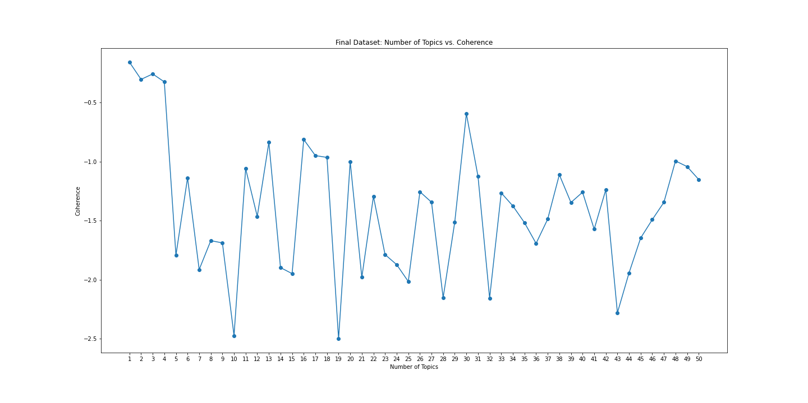

Slide 4
pyLDAvis visualizations
Like always, I computed the pyLDAvis visualizations in html format so that we can visualize the topics more easily.
For the 4-topic model, I am observing 2 topics related to education, one related to climate and the other related to geography/European geography
For the other 2 models (the one with 16 and the one with 32 topics), we still have some trash topics with unintelligible words/words that don’t appear to be in English. But, the good part is that the rest of the topics actually look fine and, for the most part, also make sense intuitively.

Slide 5

Next Steps
Perhaps we could now start tuning the parameters a bit further or try a new coherence measure. The most commonly used ones are the u_mass coherence measure (that we are using right now) and the other is c_v. I could possibly try the c_v measure and see if it discovers any new feasible number of topics for the model.
I am open to any other ideas as well.

Slide 6
THANK YOU!

